Slide 1
Group Assignment
To be presented on January 8th, 2018

Slide 2
Rules of Engagement
Number of person per group: 3
In solving a problem:
  Always mention the known variables
  Always draw an illustration of the question
Mention the computer program/application used to solve each question
Each group member must have a role in solving the assignment and during the presentation

Slide 3
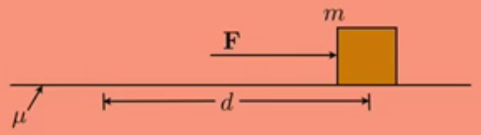
Given the situation depicted in the picture below and assuming the box moves with a constant velocity,
draw the free-body diagram of the system
define the net work done on the box
derive, analyze and explain each step of your answer
What can you conclude from your answer?
Figure 1. A box on a surface

Slide 4
Work-KE and Work-PE theorem.
    Derive the equation for
      Work-KE theorem
      Work-PE theorem, from gravity and from a spring
    Explain clearly each step
    Analyze your work and make a conclusion.
    Using Figure 1, if μ = 0.15,
      Draw the free-body diagram
      Calculate: the work done by the force, final kinetic energy, how fast the box moves, the horizontal acceleration of the box, the final speed using kinematics
      Use your own nominal for F, m, and d
    If the surface in Figure 1 is inclined by 25ᵒ
      Redraw the free-body diagram
      Derive the equation to find the final height of the box using the law of conservation of energy.
      Using computer assistance, simulate the graph the potential energy of the box (from the start to final)

Slide 5
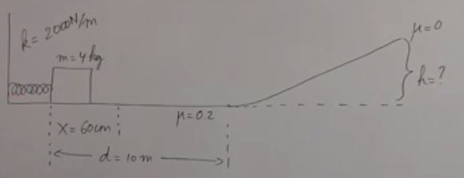
  Using the law of conservation of energy, derive the equation to find the final height of the box
  Solve the equation
  What happen to the box after it reaches the final height?

Slide 6
A 10kg ball falls from a height of 100m.
Illustrate the question
Draw the free-body diagram
Calculate (draw a table for each second)
  The vertical speed of the ball during the first 4 sec
  The height of the ball above the ground during the first 4 sec
  The kinetic and potential energy of the ball
  The total mechanical energy of the system
Using computer assistance, graph the questions above until t = 15 sec.

Slide 7
Momentum, Impulse and Energy
A 10 gram bullet is fired into a wooden block with mass M sitting on a horizontal surface. The bullet with the bullet inside it slides towards a frictionless incline of θᵒ, as far as distance d.
  Using computer assistance, illustrate the system in question
  Derive the equation of the system in conservation
  Using the obtained equation, how fast was the bullet moving when it collided with the block?
  Solve it using your own nominal for M, θ, d
  Explain your answer

Slide 8
Contact
Abqorian@gmail.com
WA: 0821-49-777-911

